Slide 1
Final Project
Custom 3D Model Rendering with Three.js

Slide 2
JavaScript’s ‘same-origin’ policy
Web-application security model.
Browser permits scripts contained in a frst web page to access data in the second page, only if both have the same origin.
‘Origin’ - URI scheme, honstname, port number.
Thus, cannot open files without browser.
Configure local HTTP server/ host on TTU MyWeb.

Slide 3


Custom 3D Model
Custom 3D model designed using Autodesk Inventor
Autodesk Developer Model Extractor using View & Data API able to convert into .json parse file.
Three.js accepts external 3D models in .json parsed .js file
Server-side REST API converts .DWF to .json stream.
NOT COMPATABLE.

Slide 4
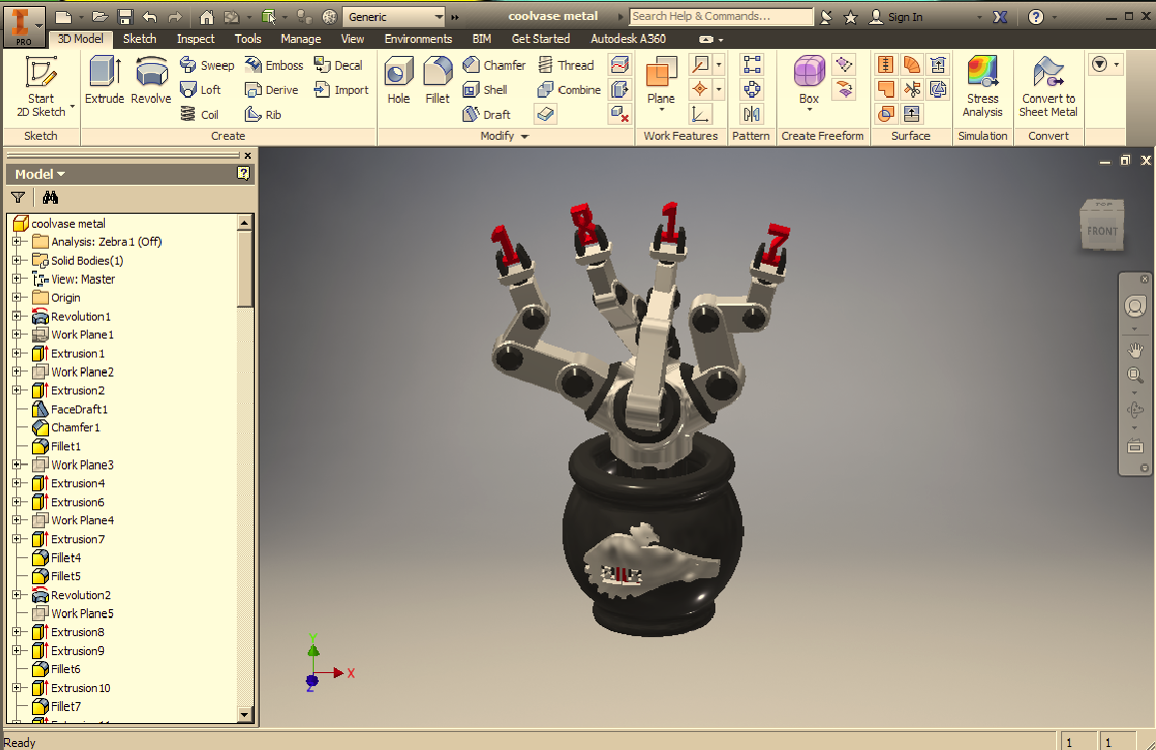
Custom 3D Model

Slide 5
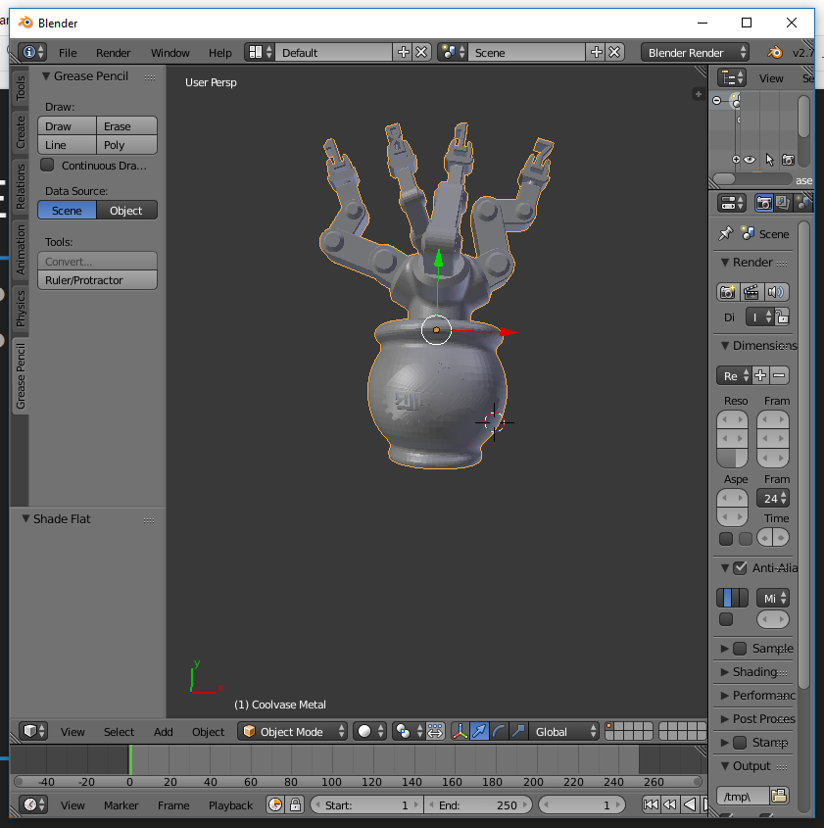
Exporting 3D Model
Export from Inventor to .STL
Using Blender 2.73 (Old Version) and custom i/o addon to export .stl to .json stream for compatible with three.js
Addon by ‘mrdoob’ with three.js example repo.

Slide 6
Result
Object Rendered available at www.myweb.ttu.edu/jepaul/webgl_projects/index.html

Slide 7
Technical Slides

Slide 8
Resource Files
OrbitControl.js
Load default control for orbiting, zooming, panning.
Maintains up direction by default. (Y+)
Efficient replacement for trackballcontrol() [drag and drop]
Three.min.js
Basic library for three.js
Coolvase.js
.json parsed object file.

Slide 9
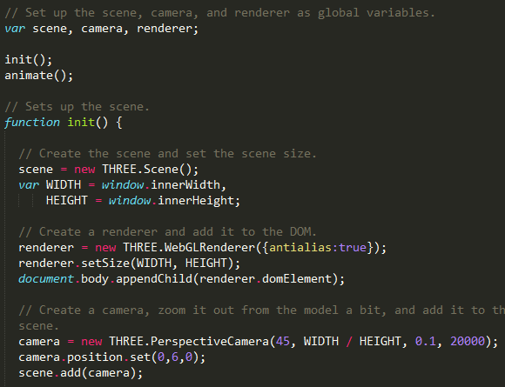
Setup and init()
Global variables
Create Scene
Scene width and height
Create renderer
WebGL renderer
Append to DOM [create canvas]
Create Camera
THREE.perspectivecamera()
FOV (45)
Aspect Ratio [From browser]
Near [initial distance to object]
Far [draw distance]

Slide 10
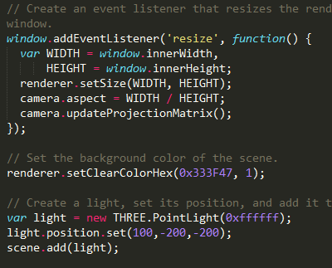
Viewport Resizing and Lighting
Viewport Update
Set up eventlistener()
get new WIDTH and HEIGHT
Update aspect ratio
updateProjectionMatrix() [update scene with new browser dimension]
Lighting
setClearColorHex() [background color]
Create PointLight source
Set source on matrix and add to scene

Slide 11
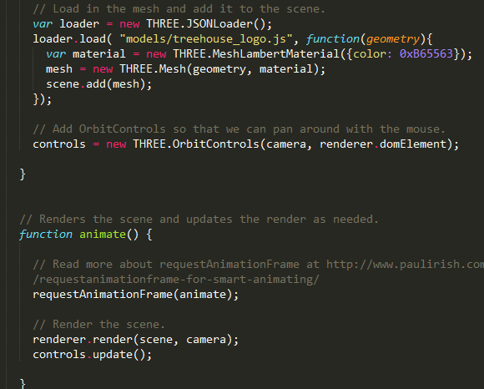
Geometry, Controls and Renderer
Geometry
.json parsed model from STL exported from Blender
JSONLoader() to load custom model on mesh
LamberyMaterial() to set model color
add to scene
OrbitalControl ()
Use mouse to interact with model
Scene Render - animate()
requestAnimationFrame() [only rendering when viewed]
render() and update controls

Slide 12
References
Treehouse.com - Beginner’s Guide to three.js http://blog.teamtreehouse.com/the-beginners-guide-to-three-js
mrdoob three.js Resource Files. Github. https://github.com/mrdoob/three.js/

